Slide 1
Improved Source of Drinking water
CAPSTONE PROJECT
Presented By:
Student Name- Soumya Suman
College Name- Samrat Ashok Technological Institute
Department- Internet Of Things(IT Department)

Slide 2
OUTLINE
Problem Statement (Should not include solution)
Proposed System/Solution
System Development Approach (Technology Used)
Algorithm & Deployment
Result (Output Image)
Conclusion
Future Scope
References

Slide 3
Problem Statement
Access to safe and improved sources of drinking water remains a significant challenge in India, particularly in rural and underdeveloped regions. Despite government initiatives aligned with the Sustainable Development Goals (SDGs), disparities persist across states and socio-economic groups. The lack of equitable water access contributes to health issues and social inequality. There is a need to analyze relevant data to better understand these disparities and inform policy interventions.

Slide 4
Proposed Solution
This project proposes a data-driven system that utilizes AI Kosh’s Multiple Indicator Survey (78th Round) dataset to analyze access to improved drinking water across Indian states. The system will use data analytics and visualization techniques to identify demographic, geographic, and socio-economic patterns. It will also correlate water access with other indicators such as clean cooking fuel usage and migration trends. The system will be deployed using IBM Cloud Lite services to enable accessible and scalable solutions.

Slide 5
System approach(technology used)
Platform: IBM Cloud Lite
Programming Languages: Python (for data preprocessing and analysis)
Libraries: Pandas, NumPy, Matplotlib, Seaborn, Plotly
Visualization Tools: IBM Watson Studio, Jupyter Notebook
Deployment: IBM Cloud Functions / IBM Watson Studio Dashboards
Dataset: AI Kosh - Multiple Indicator Survey, 78th Round
Storage: IBM Cloud Object Storage

Slide 6
Algorithm & Deployment
Data Preprocessing: Cleaning and filtering relevant indicators (e.g., drinking water source, fuel use, migration)
Analysis:
Descriptive statistics to show national/state trends
Correlation analysis between water access and other variables
Clustering (optional) to categorize regions based on similarity
Visualization:
Heatmaps, bar charts, and choropleth maps
Deployment:
IBM Watson Studio for data analytics pipeline
Dashboard hosted on IBM Cloud for interactive visualization

Slide 7
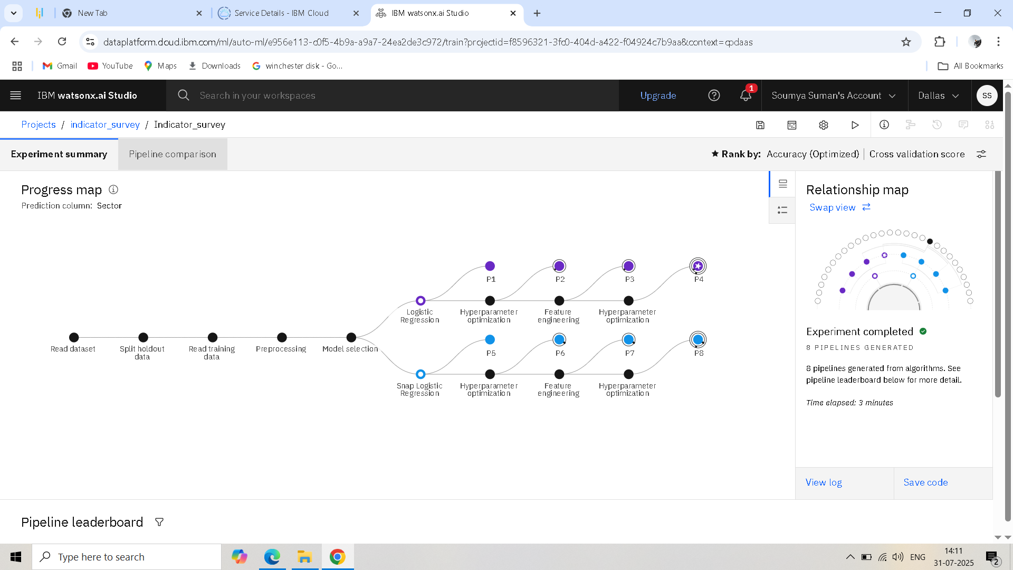
Result

Slide 8
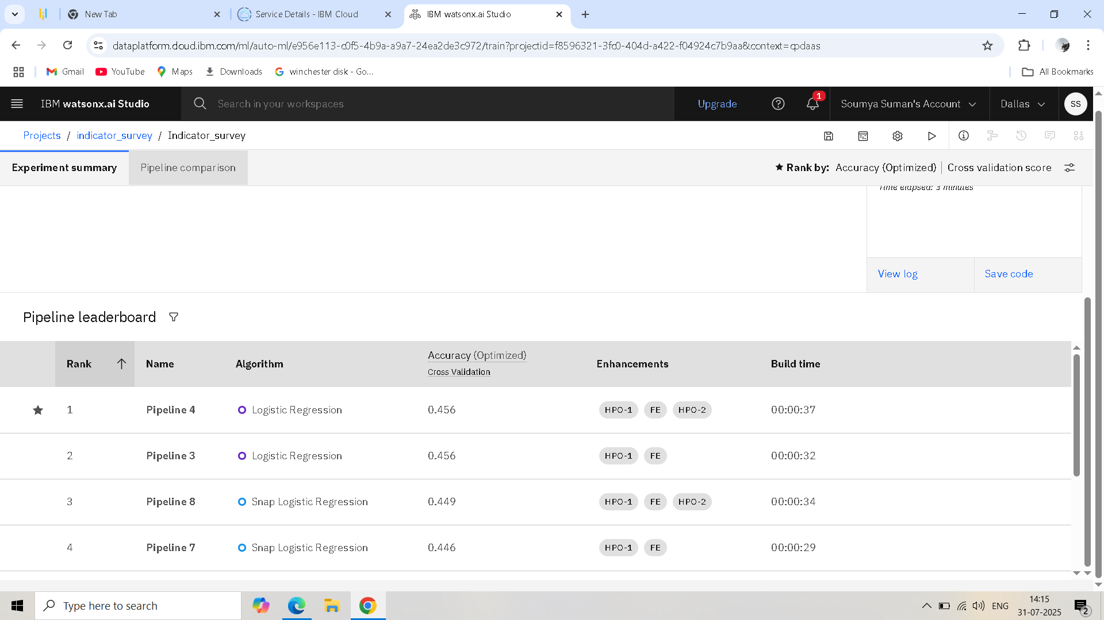
Result

Slide 9
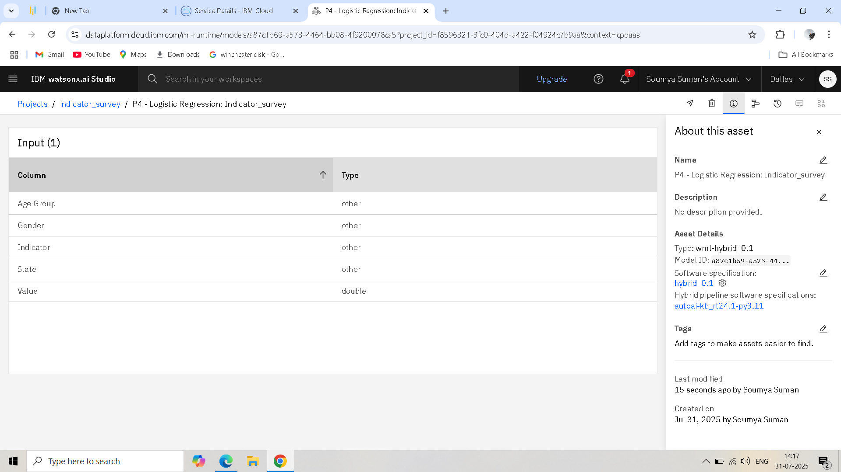
Result

Slide 10
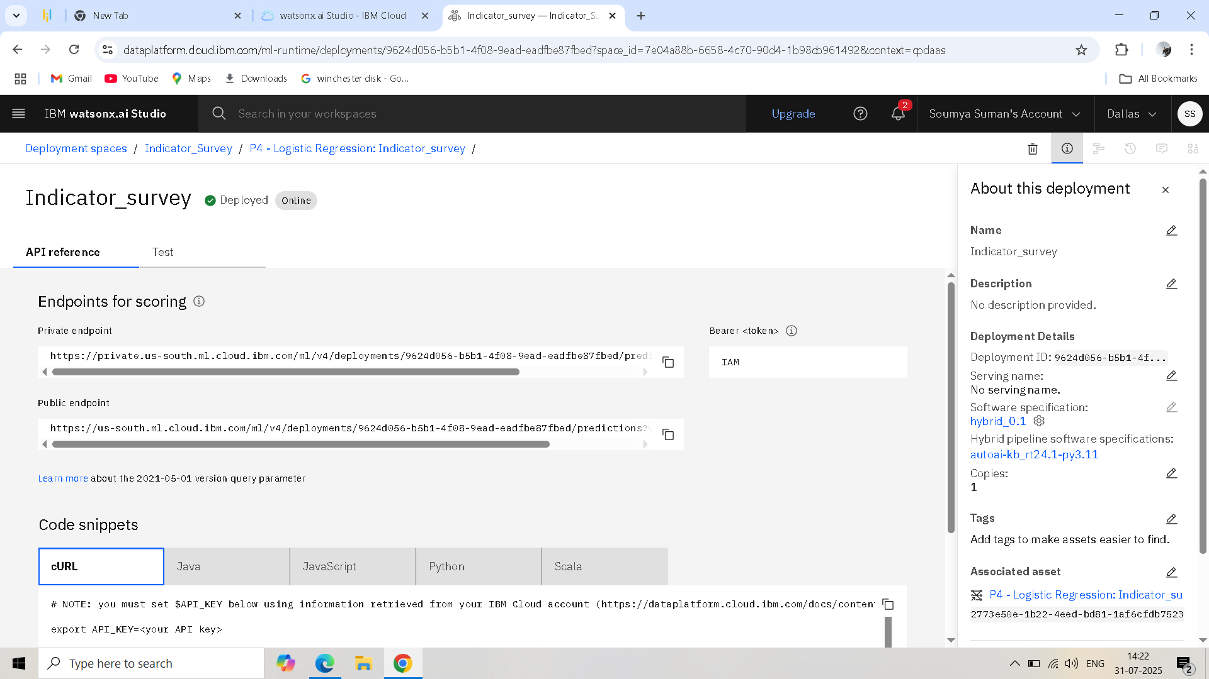
Result

Slide 11
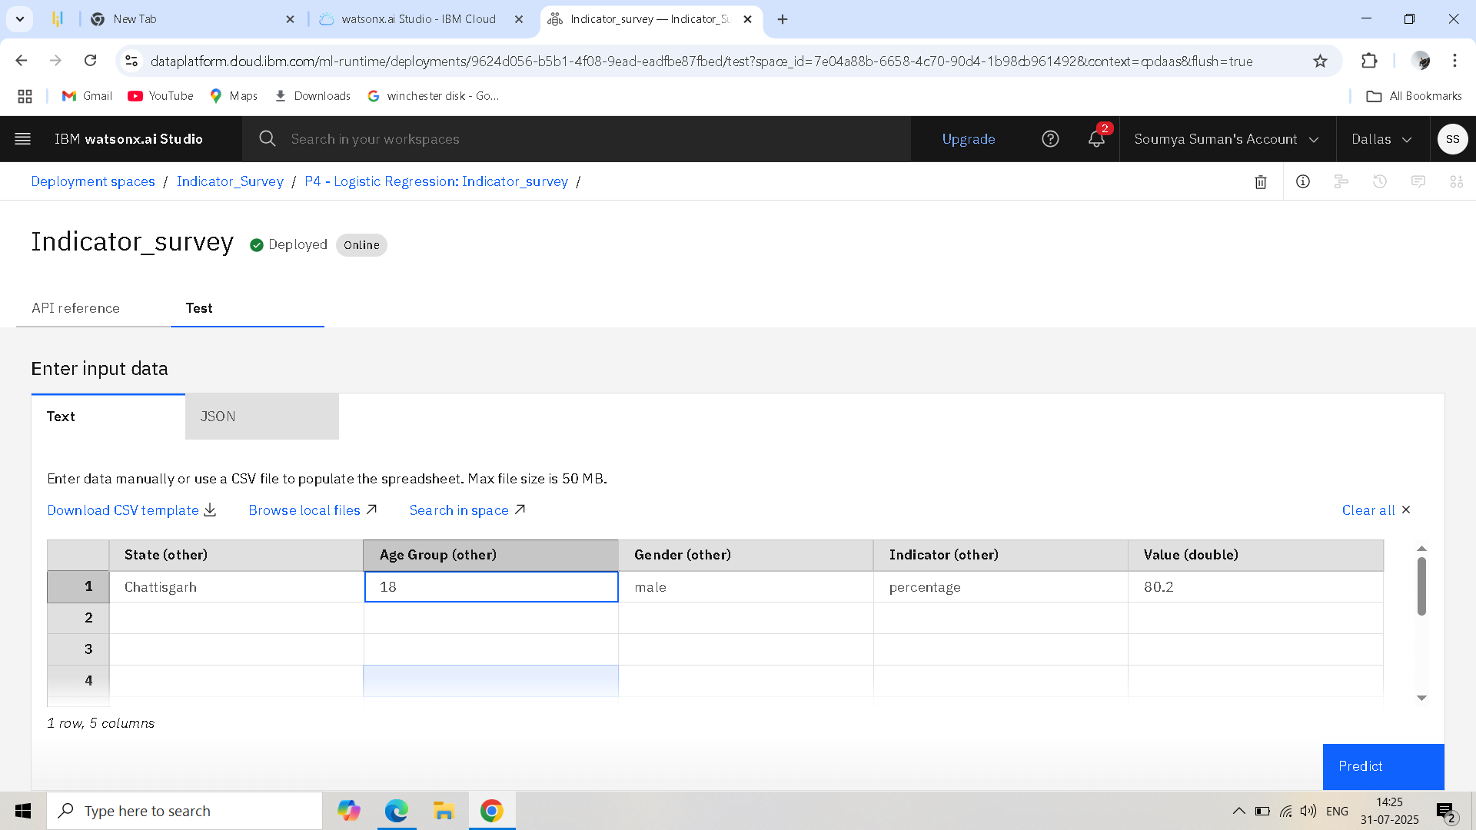
Result

Slide 12
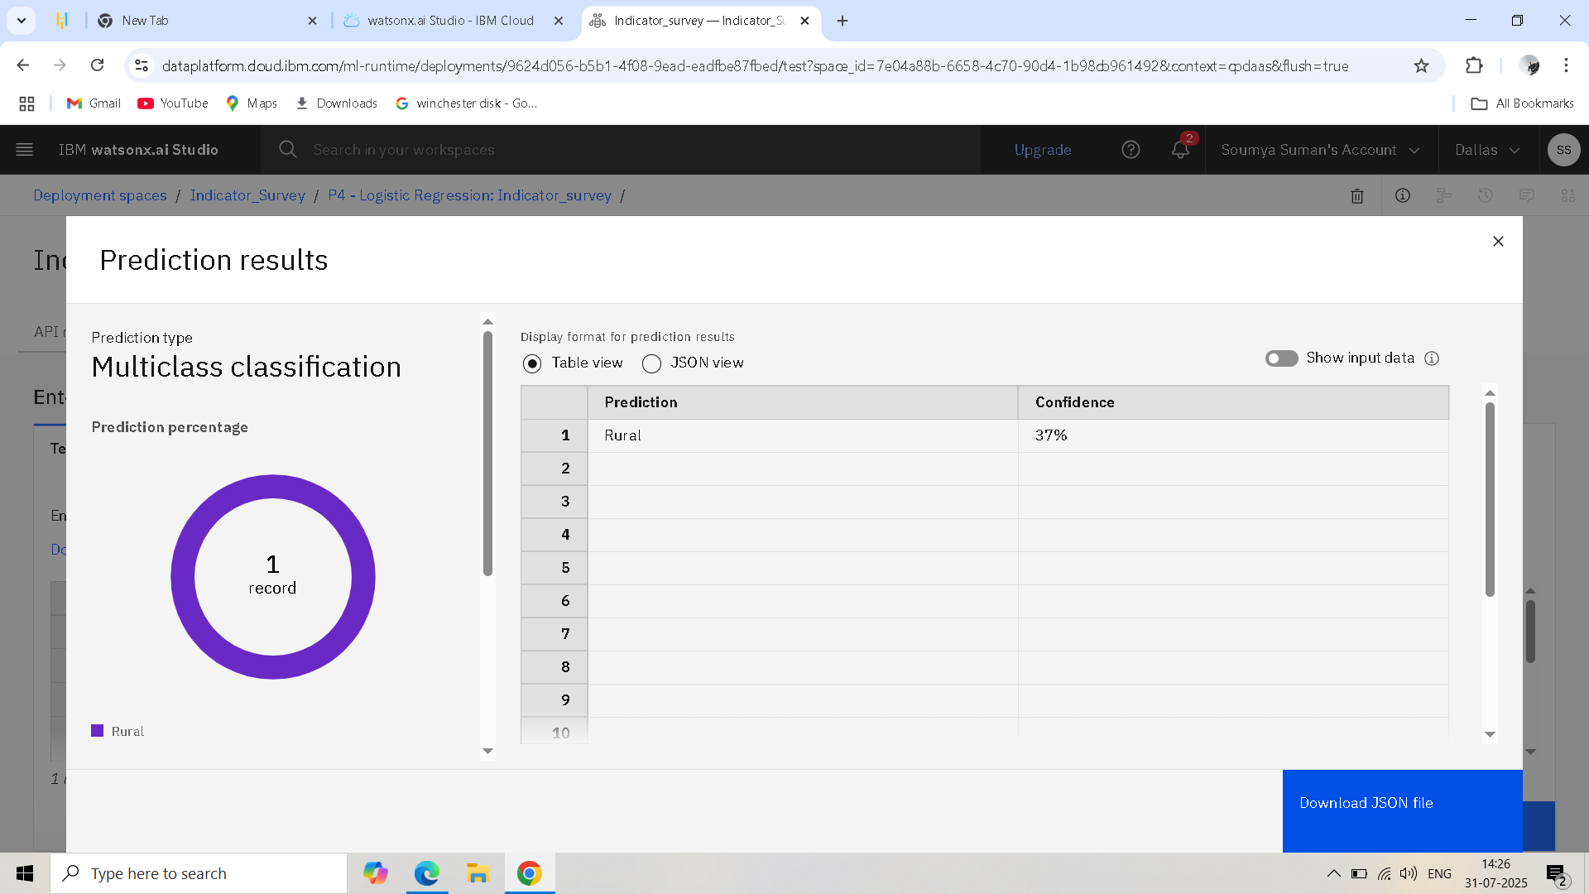
Result

Slide 13
Conclusion
The analysis highlights significant disparities in access to improved drinking water sources, with rural areas lagging behind urban counterparts. States with better access to clean cooking fuel also tend to show improved water access, suggesting socio-economic correlations. The system offers a scalable, cloud-based approach to track and visualize water accessibility metrics.

Slide 14
Future scope
Integration with real-time survey APIs for dynamic updates
Inclusion of groundwater quality data and rainfall patterns
Use of ML models to predict high-risk regions
Policy impact simulations using scenario-based modeling
Expansion to include sanitation and hygiene indicators

Slide 15
References
AI Kosh Dataset:
https://aikosh.indiaai.gov.in/web/datasets/details/improved_source_of_drinking_water_ multiple_indicator_survey_78th_round.html
2.Government of India, Ministry of Statistics and Programme Implementation
3.IBM Cloud Documentation: https://cloud.ibm.com/docs
4.United Nations Sustainable Development Goals: https://sdgs.un.org/goals

Slide 16
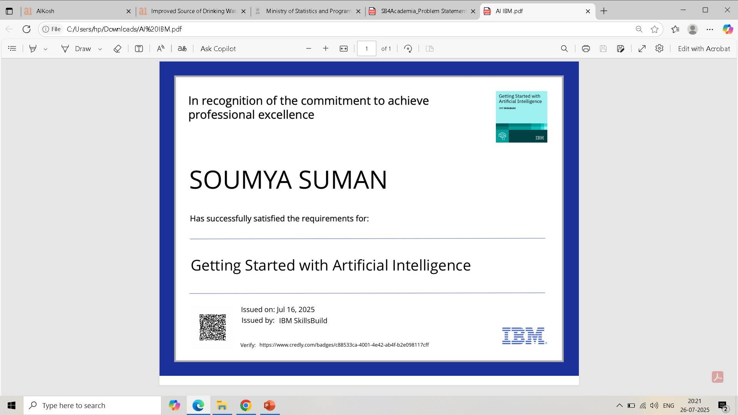
IBM Certifications

Slide 17
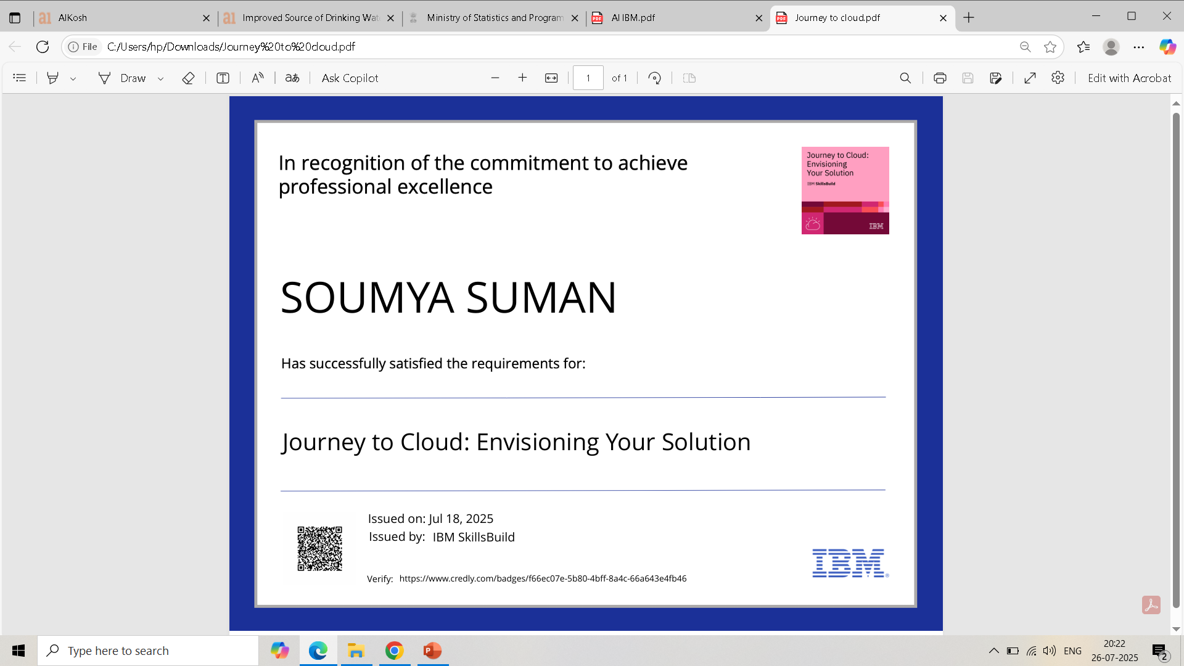
IBM Certifications

Slide 18
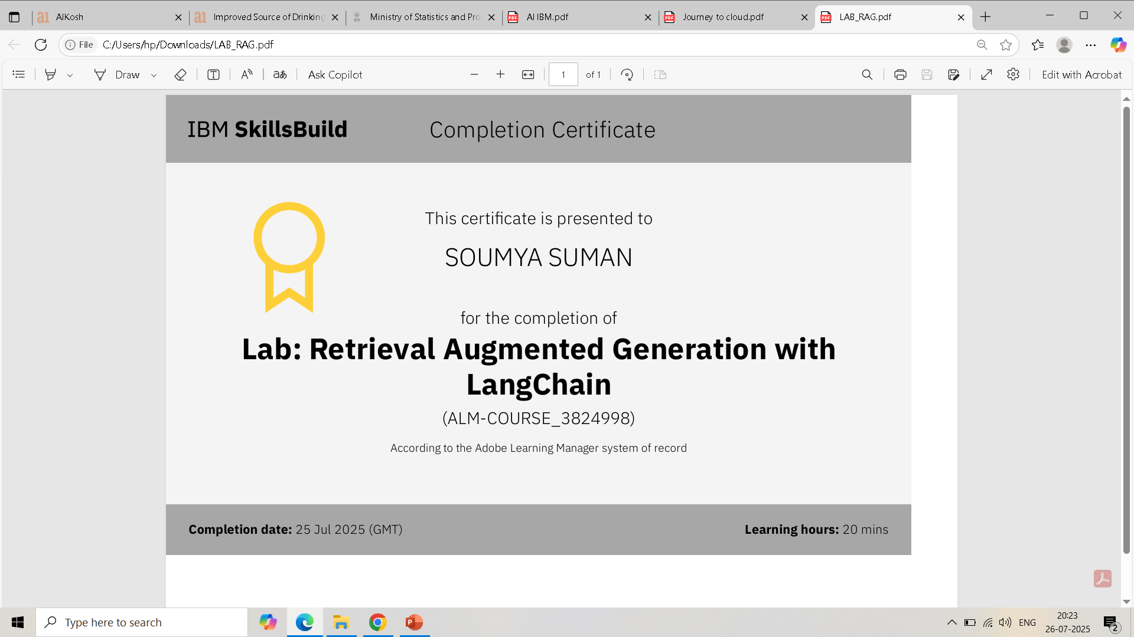
IBM Certifications

Slide 19
THANK YOU

